Slide 1
TITANIC DATA VISUALIZATION
Shivam Sahu
B-tech (CSE) Sem-V
Batch 2017-21

Slide 2

WHAT IS DATA VISUALIZATION ?

Slide 3
Data visualization is the graphical representation of information and data. By using visual elements like charts, graphs, and maps, data visualization tools provide an accessible way to see and understand trends, outliers, and patterns in data.

Slide 4

why data visualization is needed?

Slide 5
Humans process visual input above all else and faster than any other method. This is the key reason for visualizing data. Humans are visual by nature, so it helps to see data in a visual format. It’s easier to find patterns, digest, and make decisions with visual data.

Slide 6
Python
Python is a high-level programming language designed to be easy to read and simple to implement. It is open source, which means it is free to use, even for commercial applications.

Slide 7
4 Basic Libraries used in Data visualization
SEABORN
PANDAS
Seaborn is a statistical plotting library.
It has beautiful default styles.
It also is designed to work very well with Pandas dataframe objects.
It is used to perform data manipulation and analysis.
Pandas provide powerful and easy-to-use data structures and quickly perform operations on these structures.
MATPLOTLIB
NUMPY
Matplotlib is a plotting library for the
Python programming language
NumPy package is used to perform different mathematical operations.

Slide 8
Introduction with Titanic Data

Slide 9
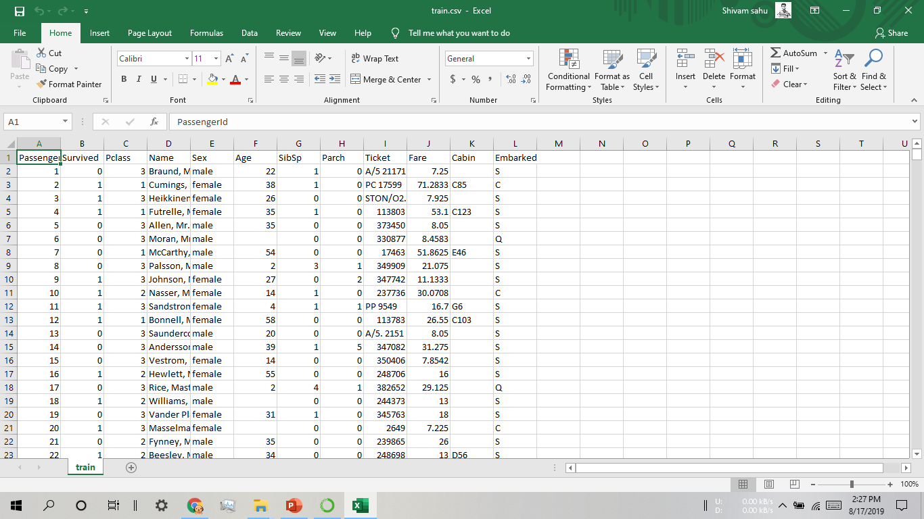

Slide 10
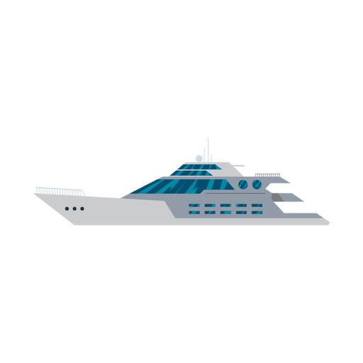
Task 1
WHO WAS THE PASSENGERS ON TITANIC ?

Slide 11
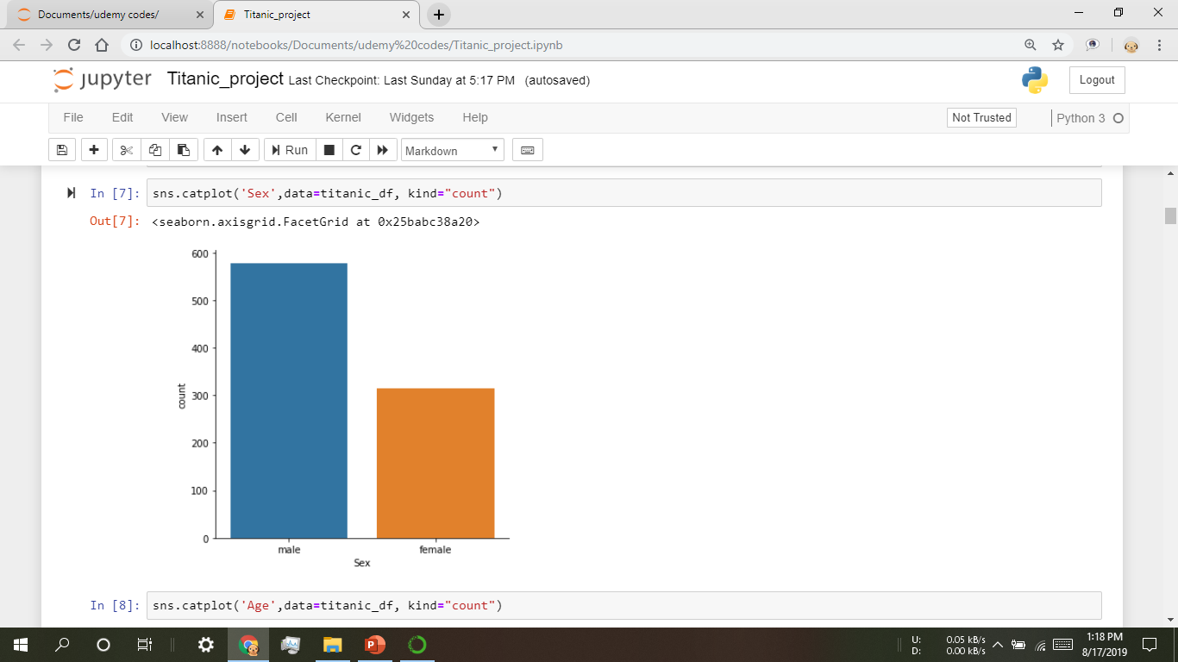
Plot 1:-
Passengers are divided on the basis of sex ratio.
Graph showing –
aproxx - 600Male
OR
300 Females

Slide 12
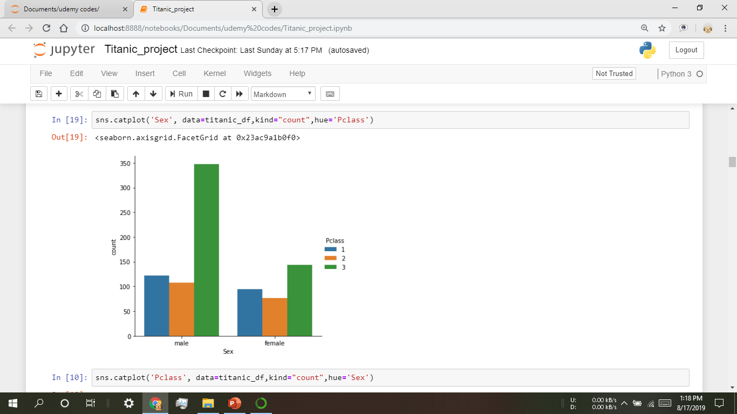
Plot 2:-
Passengers are divided on the basis of sex ratio and Pclass .

Slide 13
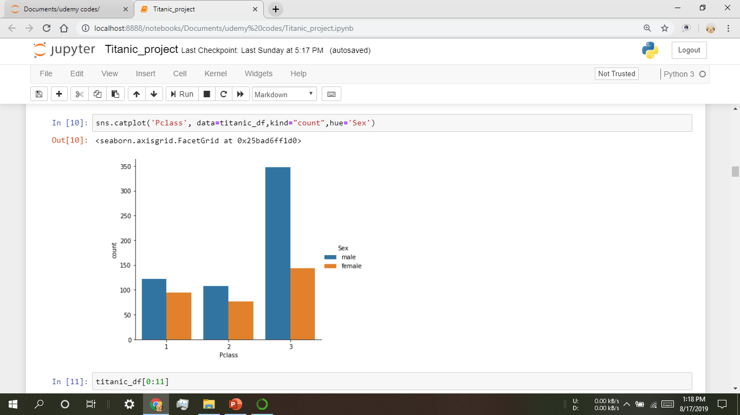
Plot 3:-
Passengers are divided on the basis of sex ratio with Pclass .

Slide 14
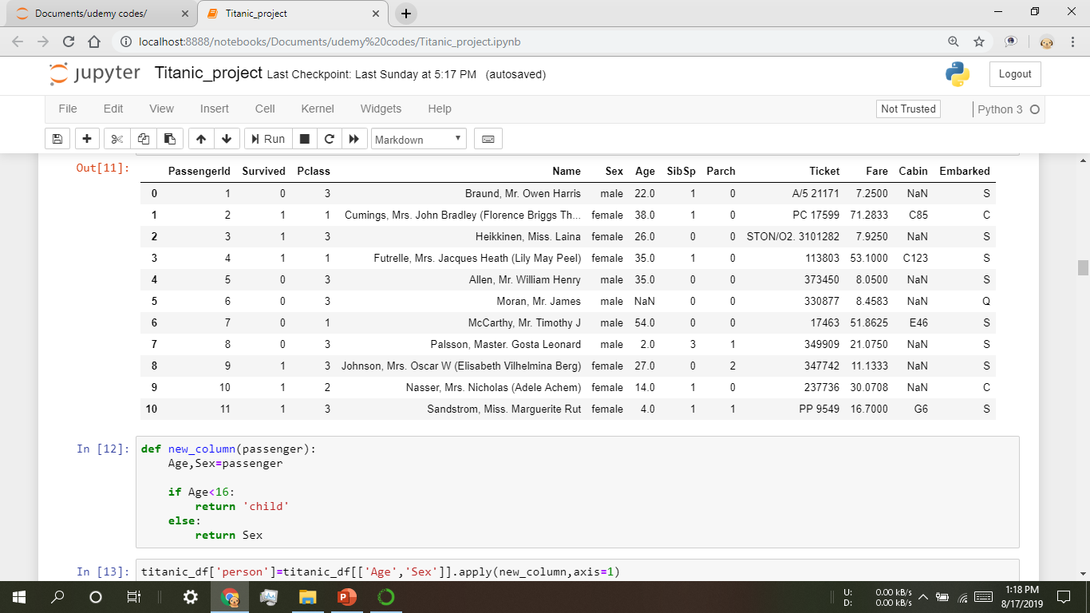
Have a look on the data:-

Slide 16
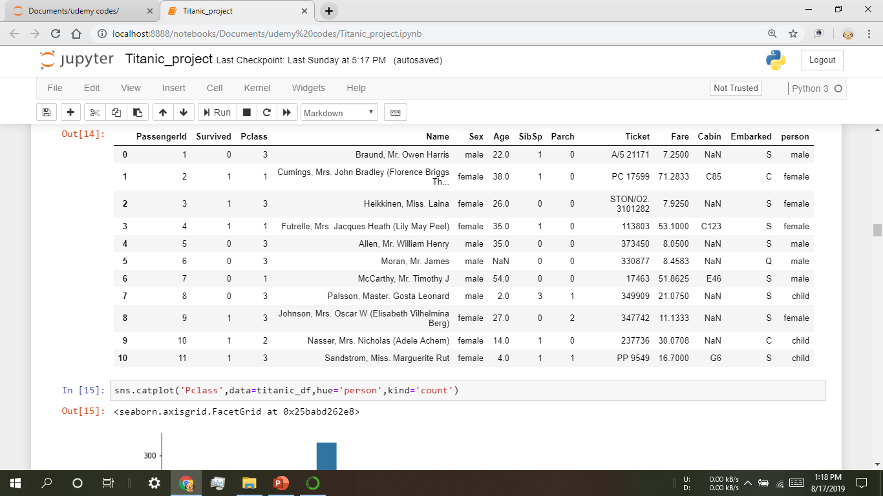

Slide 17
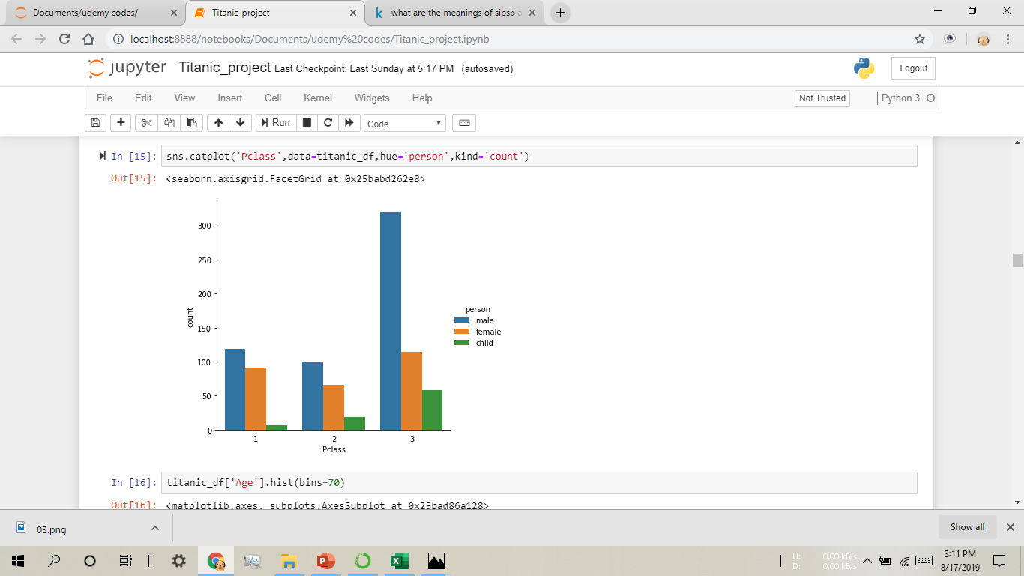
Plot 4:-
Passengers are divided on the basis of person with Pclass .

Slide 18
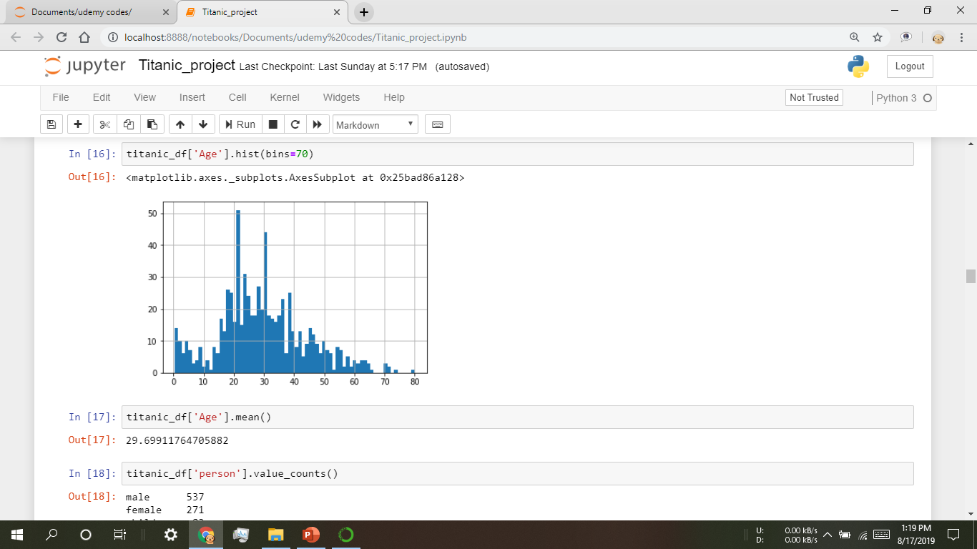
Plot 5:-

Slide 19
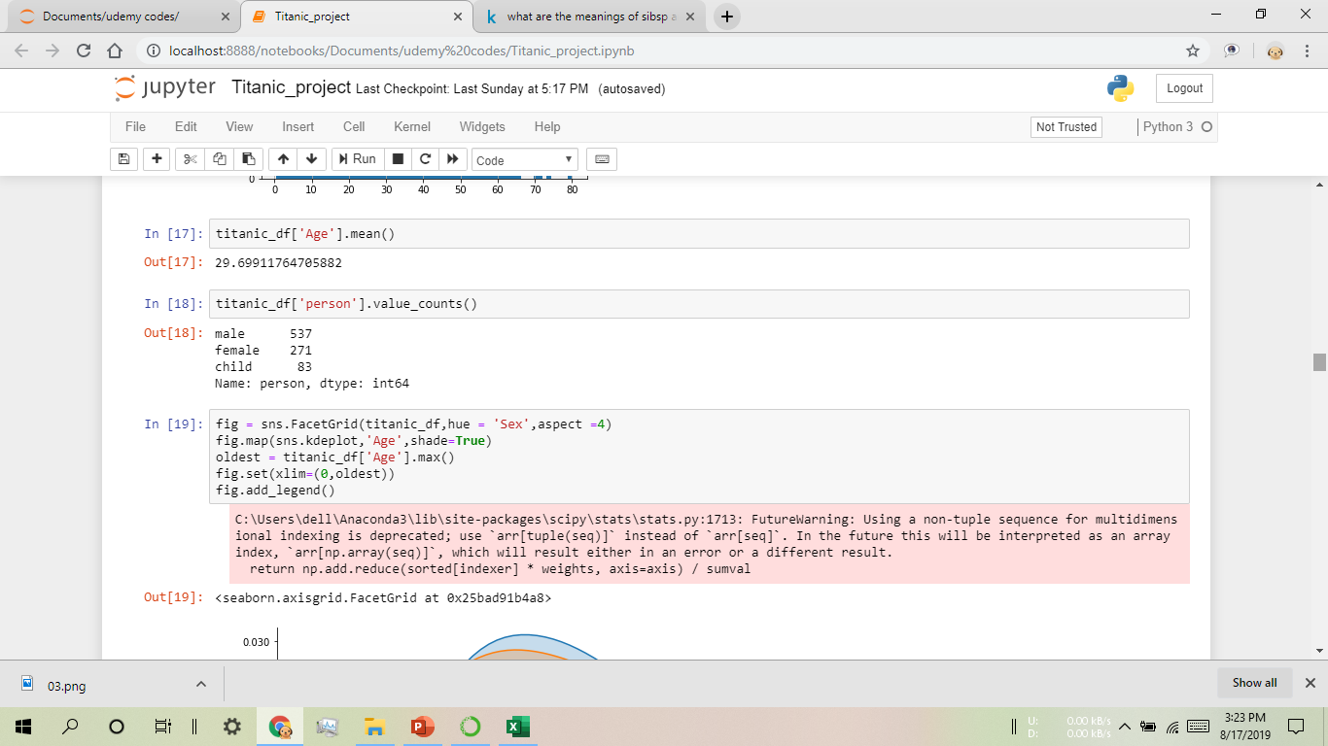

Slide 20
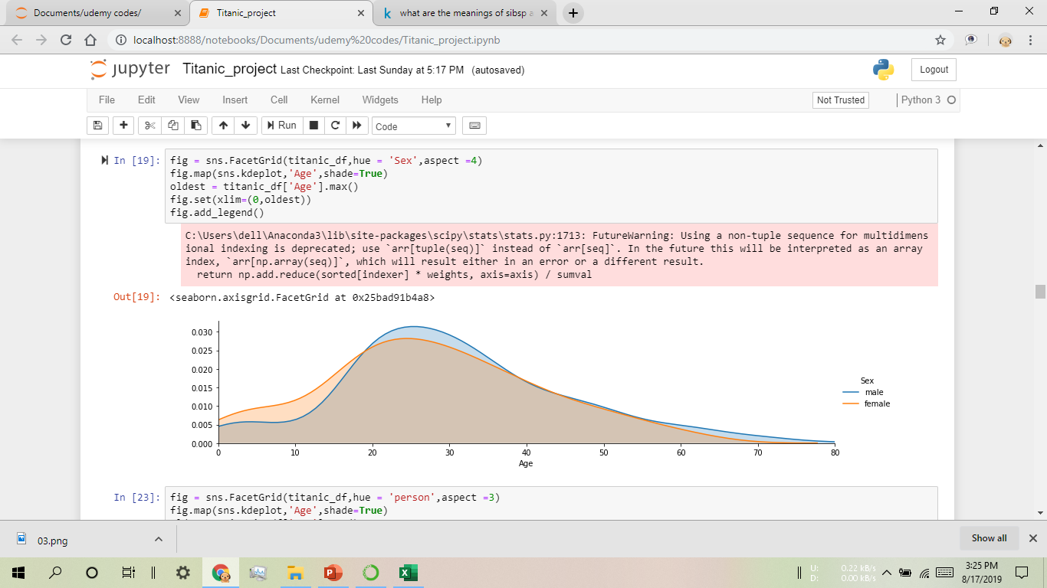

Slide 21
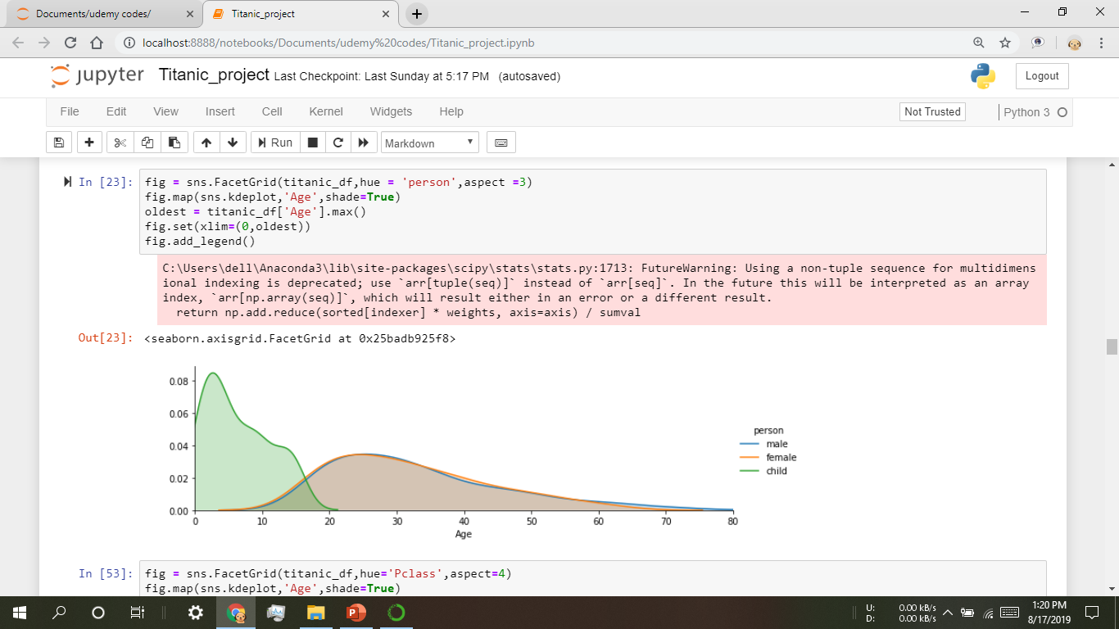
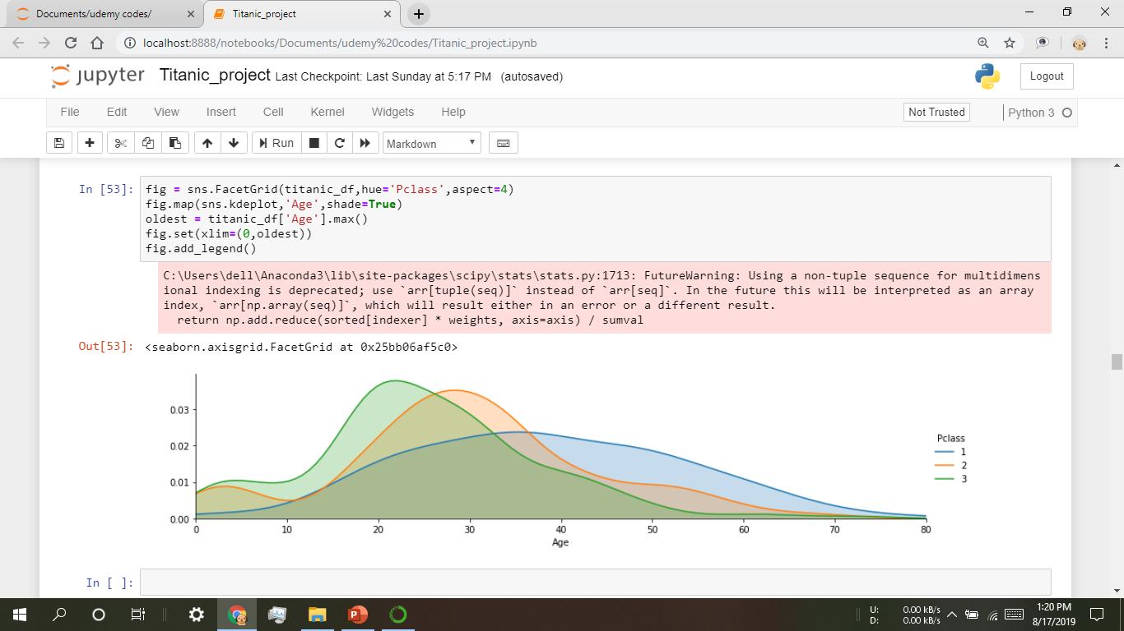
Person
Pclass

Slide 22
Task 2
What deck were the passengers on and how does that relate to their class?

Slide 23
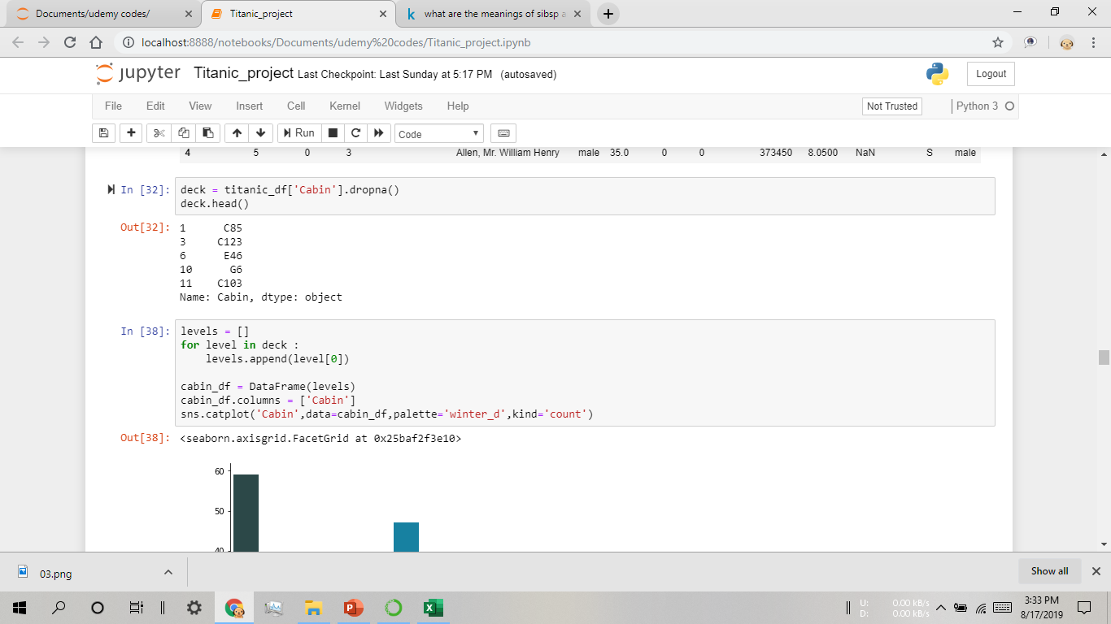

Slide 24
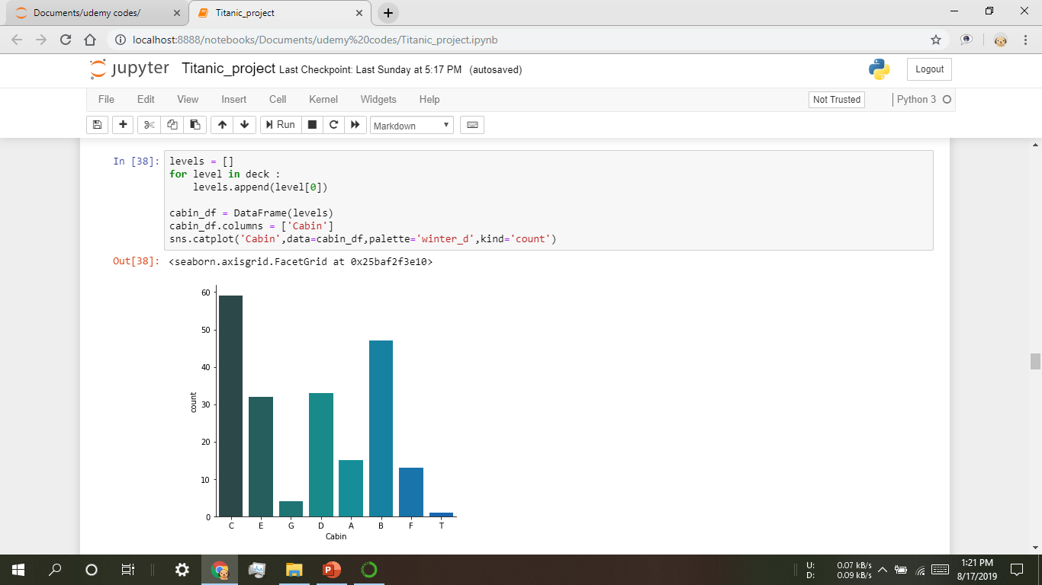
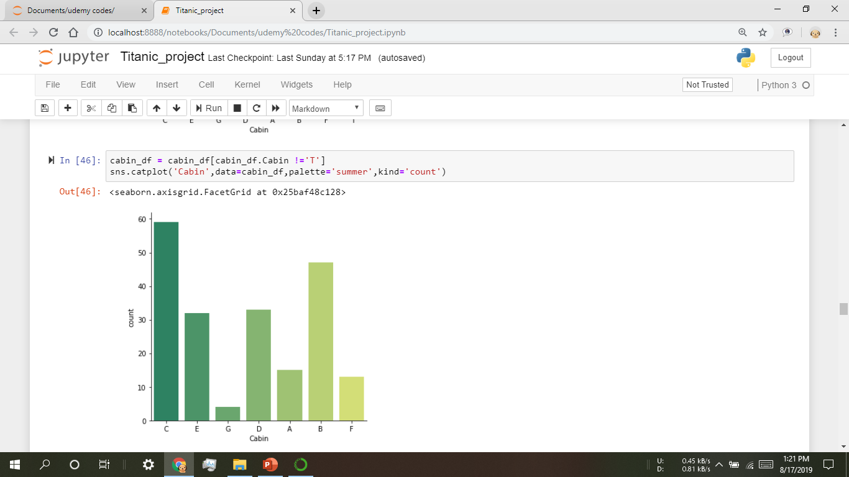
Plot 1:-
Plot 2:-

Slide 25
Task 3
Where did the passengers come from?

Slide 26
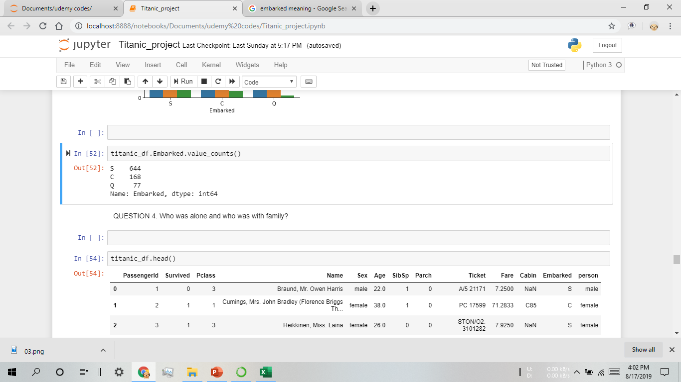
Cherbourg Port
Queenstown Port
Southampton Port

Slide 27
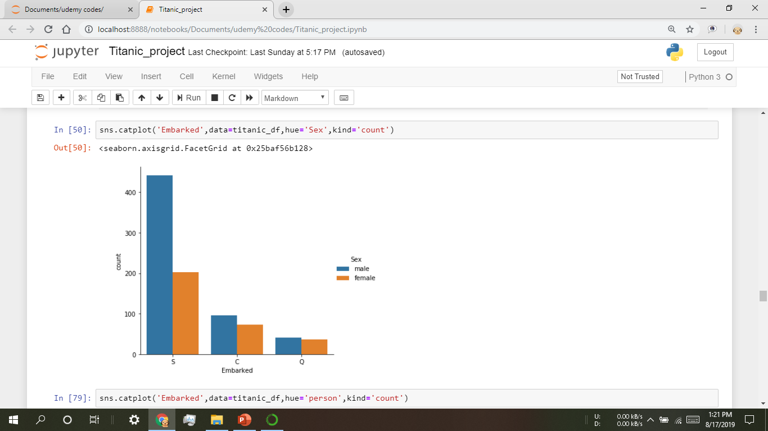
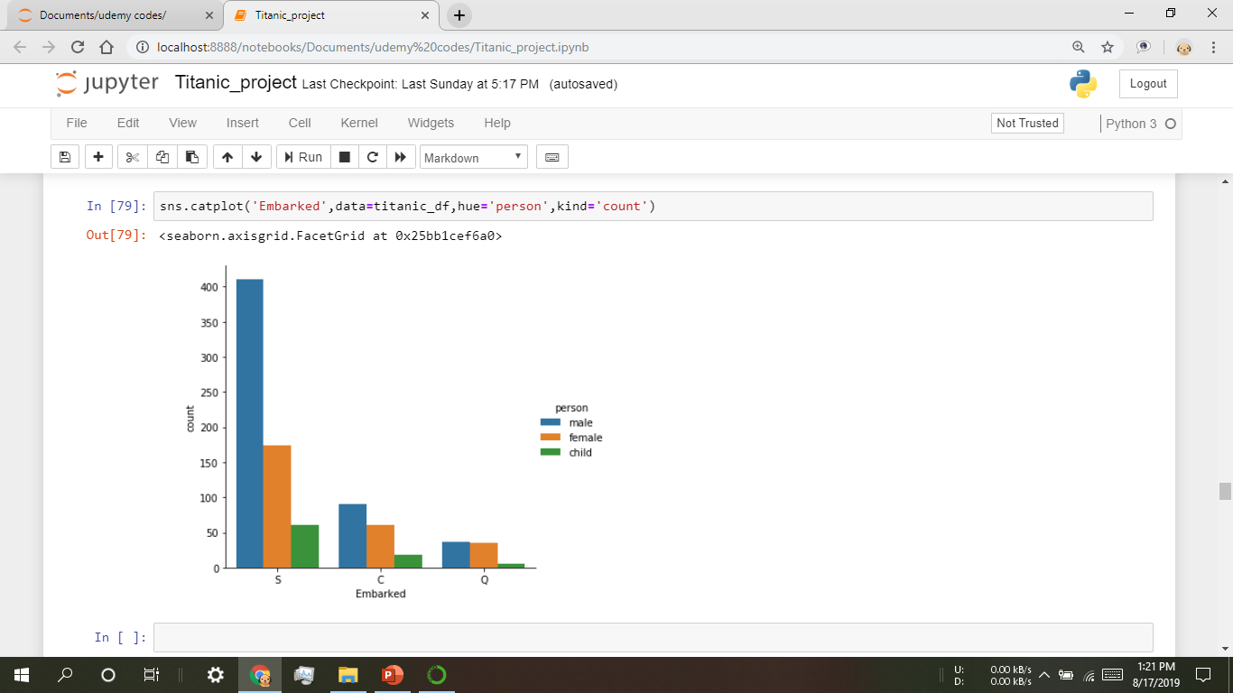
Plot 1:-
Plot 2:-
Graph show’s that from where the people belongs to.

Slide 28
Task 4
Who was alone and who was with family?

Slide 29
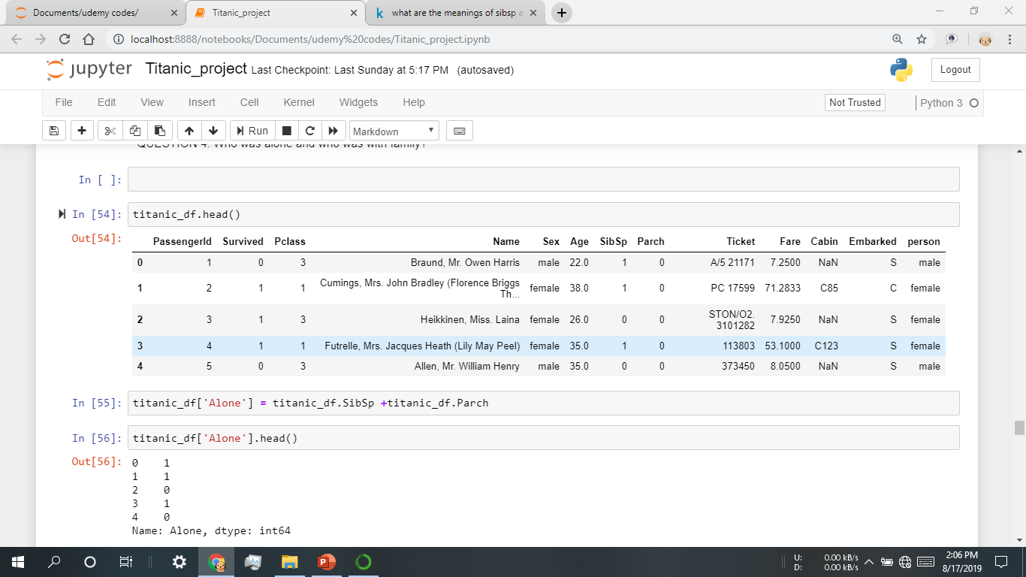

Slide 30
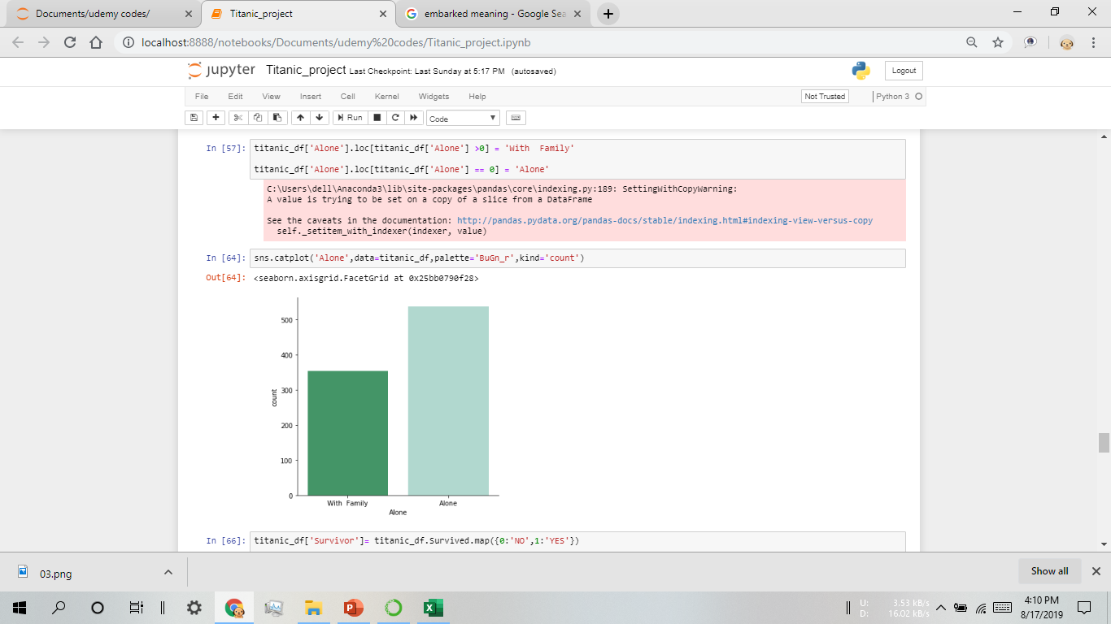
Plot 1:-
Graph showing How many passengers are Alone or
with Family

Slide 31
Task 5
How many passengers were survived?

Slide 32
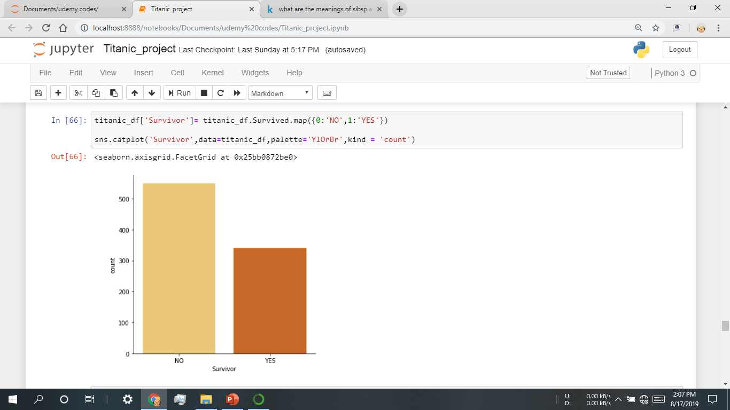
Plot 1:-
Graph showing How many passengers survived.

Slide 33
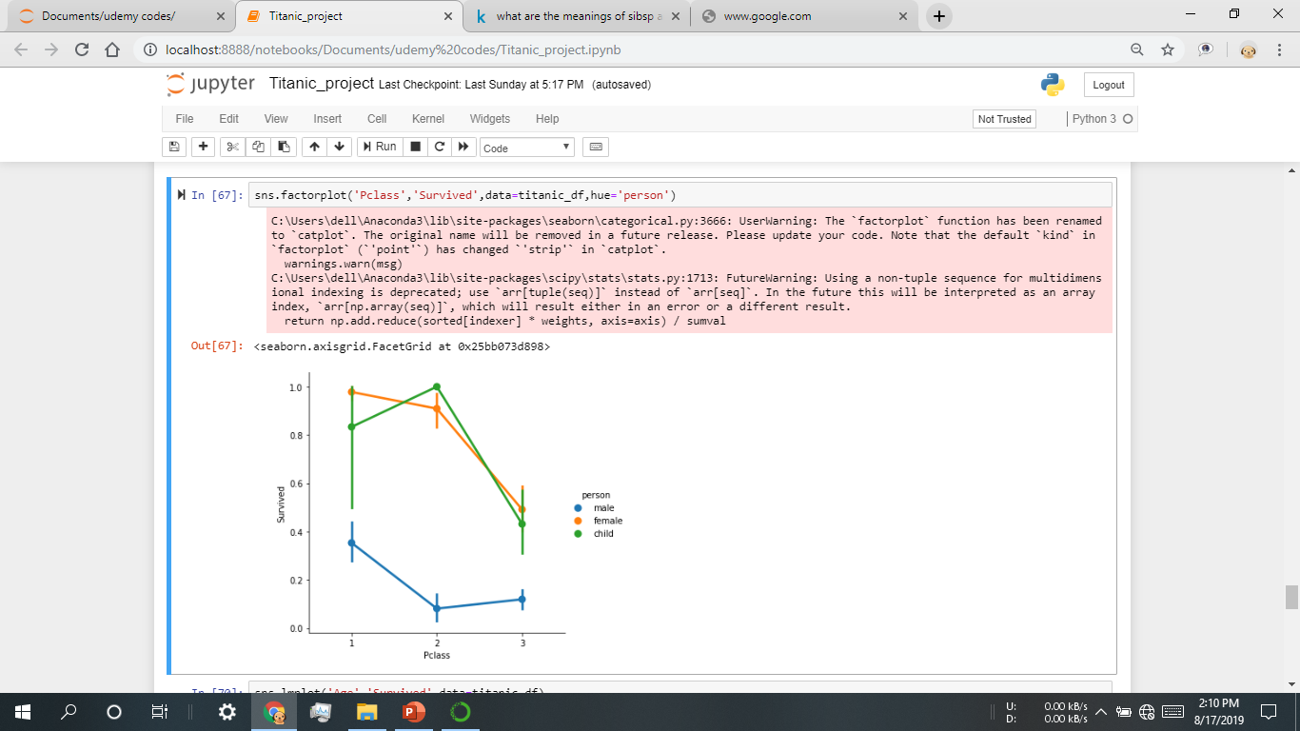
Plot 2:-
Graph showing How many passengers survived.

Slide 34


